Slide 1

Retail Inventory Optimization
(Optimizing stock levels to identify fast and slow-moving
items for predictive Inventory management)
Submitted By
Mainavathy.E

Slide 2
Retail Inventory
Analytics
Optimizing stock levels across 5,000 product records

Slide 3

Dataset Overview
Scale
5,000 records
20 columns
21 null values handled
Key Features
SKU details & categories
Stock levels & turnover
Pricing & discounts
Warehouse locations
Supplier lead times

Slide 4

Data Preparation
01
Import & Explore
Loaded dataset, checked structure and statistics
02
Clean Data
Handled nulls, standardized columns, removed duplicates
03
Engineer Features
Calculated turnover, average stock, item classifications
04
Database Setup
Connected to MySQL, saved cleaned data

Slide 5

Data Analysis with SQL
Performance Tracking
Reorder Intelligence
Find best-selling SKUs & slow movers
Stock alerts, supplier analysis, warehouse priorities
Measure warehouse & category performance
Sales Insights
Monthly trends, pricing impact, discount effectiveness

Slide 6




Power BI Dashboard
Total Inventory KPIs
Category & Warehouse Performance
Stock in/out, turnover rate, sales value
Visual comparisons across locations
Reorder Alerts & Forecasts
Monthly demand predictions

Slide 7

Stock Performance
5K
4
10
Products Analyzed
Dashboard Views
Comprehensive SKU coverage
Analysis Tables
Interactive reporting
Structured insights

Slide 8
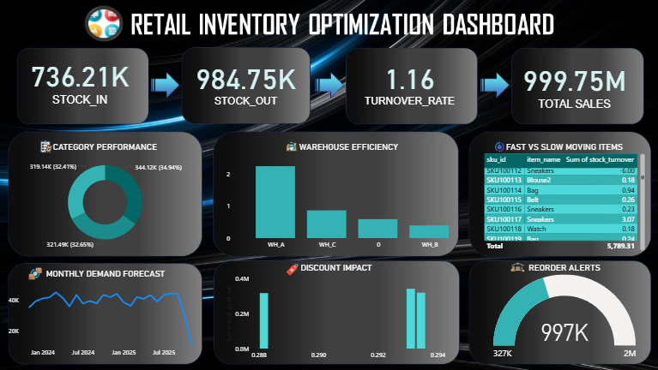

Slide 9

Fast vs Slow Movers
Fast-Moving Items
Slow-Moving Items
Above-average turnover
Below-average turnover
Maintain sufficient stock
Consider promotions
Monitor closely across warehouses
Optimize inventory levels

Slide 10








Strategic Recommendations
Reorder Automation
Warehouse Optimization
Trigger when stock falls below threshold
Balance stock based on turnover rates
Pricing Strategy
Supplier Management
Adjust discounts to boost sales
Partner with faster lead time suppliers

Slide 11


Impact of Discount Strategy
Analysis shows correlation between discount levels and stock movement across categories
Higher discounts drive faster turnover
Category-specific optimization needed
Balance margins with inventory velocity

Slide 12




Implementation plan
Deploy Dashboard
Roll out Power BI to stakeholders
Set Alerts
Set up reorder notifications
Monitor Performance
Track KPIs monthly and adjust strategy

